Slide 1
Introduction to Theatre
A Rich and Dynamic Art Form

Slide 2
What is Theatre?
Theatre is a collaborative form of performing arts that involves live performances of actors on stage.
It encompasses various elements such as acting, directing, set design, costumes, lighting, and sound to create a unique experience for the audience.
Theatre has a long history and has evolved into different genres and styles across cultures and time periods.

Slide 3
The Importance of Theatre
Theatre plays a vital role in society and has numerous benefits.
It is a powerful means of storytelling, allowing us to explore and understand the human experience.
Theatre promotes empathy, critical thinking, creativity, and cultural understanding.

Slide 4
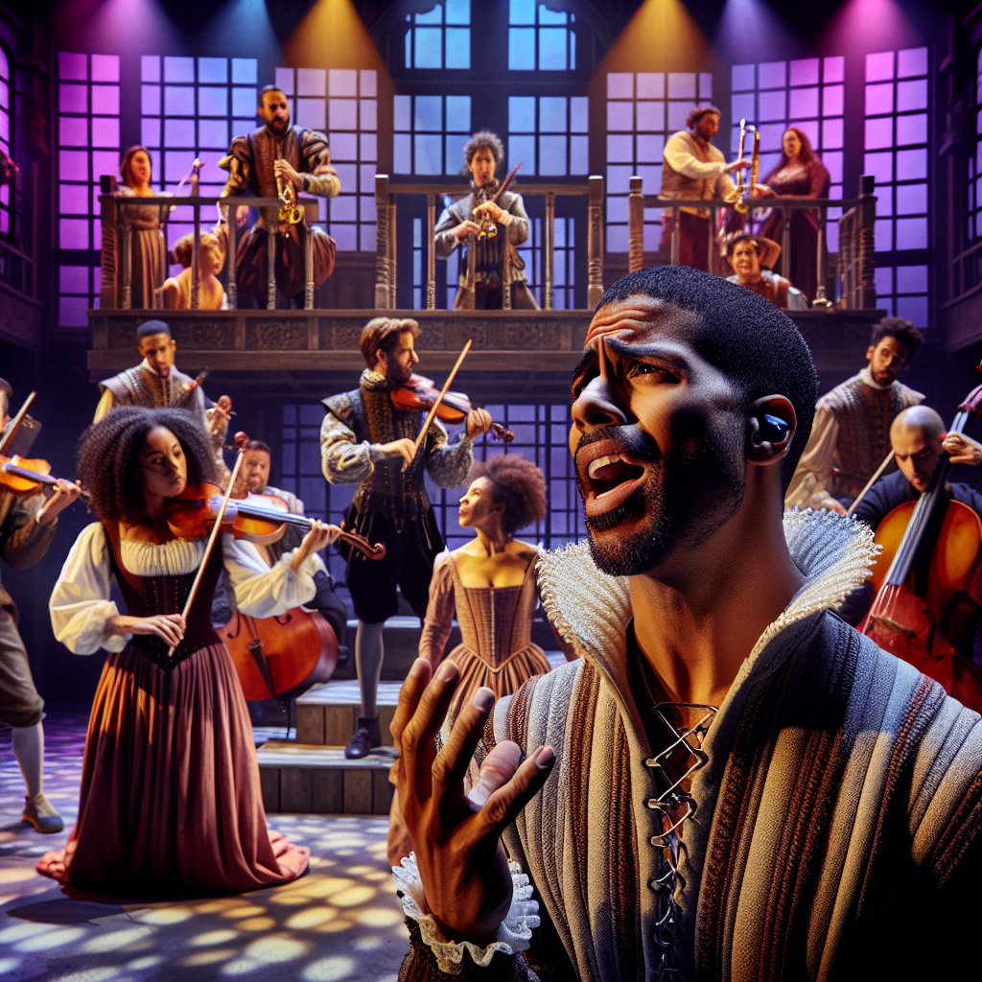
Different Types of Theatre
Theatre encompasses a wide range of genres and styles.
Musical theatre combines acting, singing, and dancing to tell a story through music and lyrics.
Other types include drama, comedy, experimental, physical theatre, and classical works such as those by William Shakespeare.
Musical Theatre

Slide 5
Theatrical Elements
Theatre production involves various elements to create a cohesive and engaging experience.
Set design creates the visual environment of the play, while costumes help define characters.
Lighting and sound design enhance the mood and atmosphere of the performance.

Slide 6
Acting and Performance
Acting is at the heart of theatre, bringing characters to life through performance.
Actors use various techniques to portray emotions, convey messages, and engage with the audience.
Performance also involves physicality, voice projection, and stage presence.

Slide 7
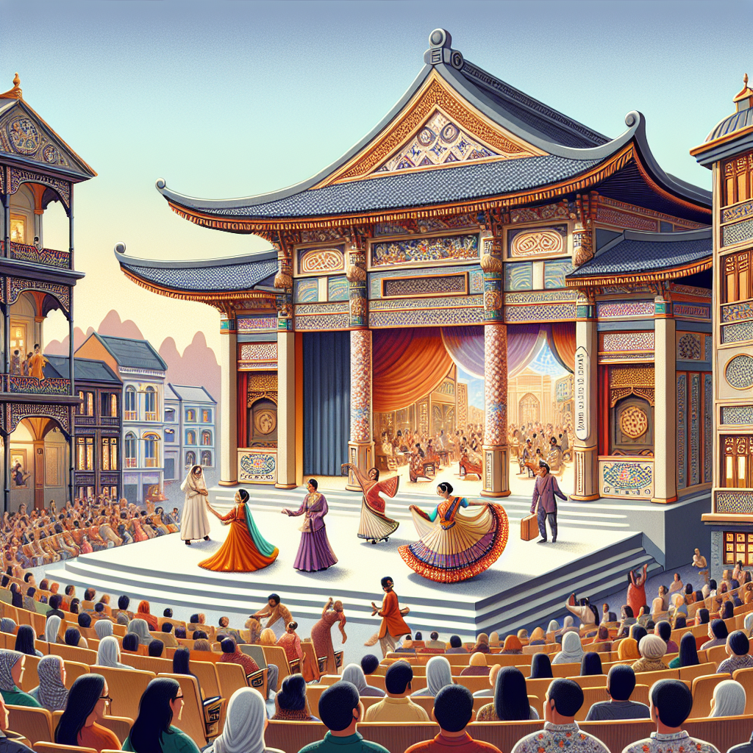
Theatre Around the World
Theatre is a global art form, with different cultures contributing their unique traditions and styles.
Traditional theatre forms include Japanese Noh, Indian Kathakali, Chinese Opera, and Greek Tragedy.
Exploring theatre from different cultures expands our understanding and appreciation of the art.
Traditional Theatre

Slide 8
Theatre and Society
Theatre has a significant impact on society and reflects its values and concerns.
It addresses social, political, and cultural issues, provoking thought and dialogue.
Theatre can be a platform for social change, raising awareness and challenging conventions.

Slide 9
Famous Playwrights and Performances
Throughout history, numerous playwrights have made lasting contributions to theatre.
William Shakespeare is widely regarded as one of the greatest playwrights, with works like Romeo and Juliet and Hamlet.
Other notable playwrights include Anton Chekhov, Tennessee Williams, and August Wilson.

Slide 10
Theatrical Careers and Education
Theatre offers diverse career opportunities for individuals passionate about the art.
Acting, directing, stage management, lighting design, and playwriting are some of the potential career paths.
Education and training in theatre can be pursued through acting schools, drama programs, and conservatories.

Slide 11
The Future of Theatre
Theatre continues to evolve and adapt to the changing world.
Technological advancements, interdisciplinary collaborations, and diverse voices shape the future of theatre.
Innovation and experimentation will drive the art form forward, while preserving its essence.

Slide 12
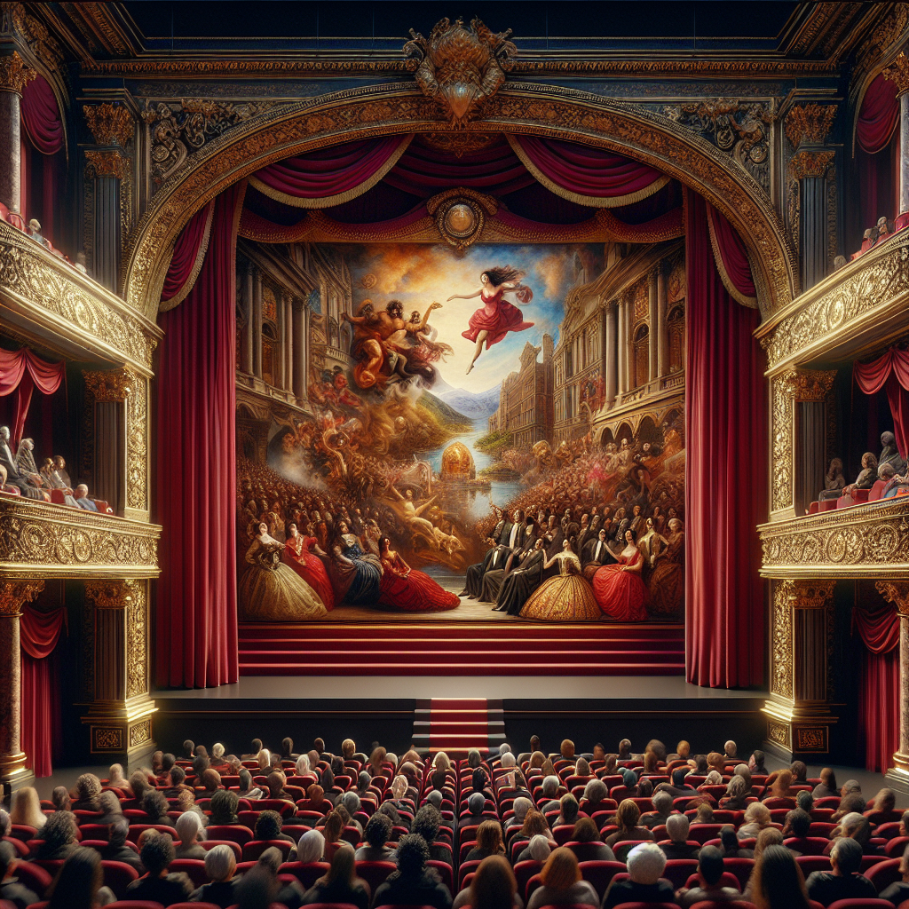
Conclusion
Theatre is a vibrant and transformative art form that explores the human condition.
Through collaboration, storytelling, and performance, it has the power to entertain, inspire, and provoke.
As audiences and artists continue to engage with theatre, it will remain a vital and cherished part of our cultural landscape.
Theatre

Slide 13
References
1. Brockett, O., & Hildy, F. (2014). History of the Theatre. Pearson.
2. Cohen-Cruz, J., & Schutzman, M. (2005). A Boal Companion: Dialogues on Theatre and Cultural Politics. Routledge.
3. Fischer-Lichte, E., & Wihstutz, A. (2017). The Routledge Introduction to Theatre and Performance Studies. Routledge.

Slide 14
Thank You
Thank you for your attention!
Any questions?

